Slide 1
CFS 스케줄러 파라메터
국민대학교 임베디드 연구실
경 주 현
2017 LG MC 인재육성팀 교육

Slide 2
Outline
CFS 스케줄러 파라메터 설명
파라메터 변경 후 Trace

Slide 3
Why talk about parameters?
CFS scheduler depends on CFS parameters.
Parameters prevent context switch overhead.
Tuning Value
sched_nr_latency
sysctl_sched_latency
sysctl_sched_min_graularity
sysctl_sched_wakeup_granularity

Slide 4
CFS time slice
time_slice =
(sched_period * se.load.weight) / cfs_rq.load.weight;

Slide 5
Time slice and task load
time_slice =
(sched_period * se.load.weight) / cfs_rq.load.weight;
nr_running : number of threads in runqueue
if nr_running <= nr_latency
sched_period = sched_latency
else
sched_period = min_granularity x nr_running

Slide 6
Parameter values
rq->nr_running
sched_nr_latency
sched_latency_ns / sched_min_granularity
sched_latency_ns
예 : 6000000 * factor(3) = 18000000(ns)
“/proc/sys/kernel/sched_latency_ns”
factor
스케일링 정책에 따른 비율 (예 - factor=3)
sched_min_granularity
최소 스케쥴 기간
예) 750000 * factor(3) = 2250000(ns)
“/proc/sys/kernel/sched_min_granularity_ns”
sched_wakeup_granularity_ns
태스크의 wakeup 기간으로 디폴트 값(1000000) * factor(3) = 3000000(ns)
“/proc/sys/kernel/sched_wakeup_granularity_ns”

Slide 7
vruntime
vruntime +=
delta_exec * (NICE_0_LOAD / curr->load.weight);
delta_exec
the time spent by the task since the last time vruntime was updated

Slide 8
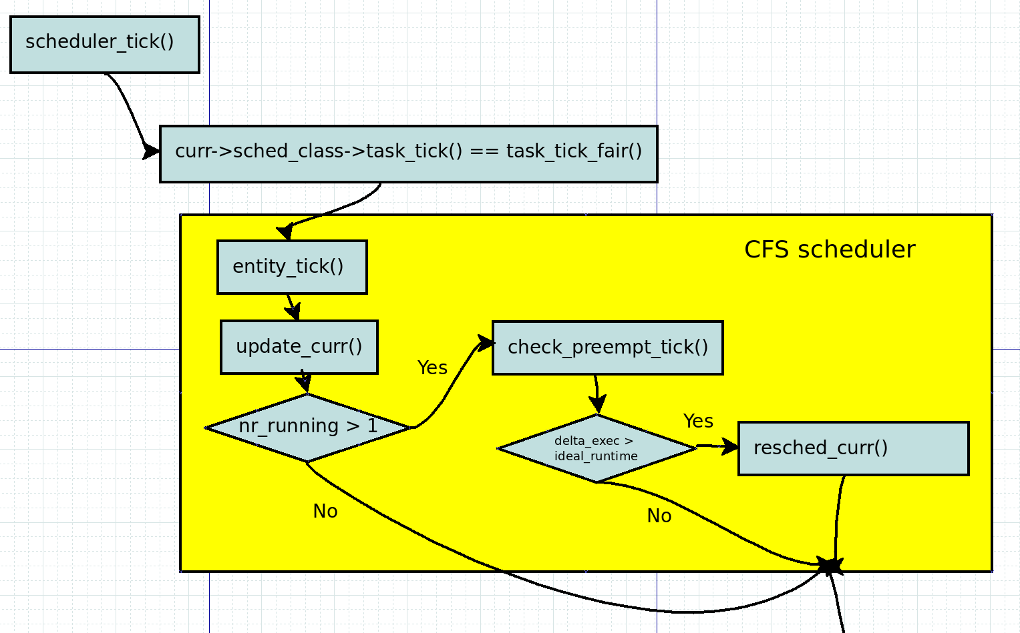
When schedule a task
Scheduler Tick

Slide 9
check_preempt_tick
delta_exec
the time spent by the task since the last time vruntime was updated
if (delta_exec > time_slice)
reched_task();
else if ((delta_exec < min_granularity)
retrun; // To prevent context switch overhead

Slide 10
wakeup_preempt_entity
gran =
sched_wakeup_granularity * (NICE_0_LOAD / se>load.weight);
cur : wake-up task, se : running task
if (cur->vruntime <= se->vruntime)
return;
else ((cur->vruntime - se->vruntime) > gran)
resched_task();

Slide 11

Next Step.
Energy-aware scheduling: EAS
Load Balancer(Group Scheduling, Bandwidth Control, PELT)
EAS features

Slide 12
Reference
https://pdos.csail.mit.edu/6.828/2016/schedule.html
http://web.mit.edu/6.033
http://www.rdrop.com/~paulmck/
“Is Parallel Programming Hard, And If So, What Can You Do About It?”
Davidlohr Bueso. 2014. Scalability techniques for practical synchronization primitives. Commun. ACM 58
http://queue.acm.org/detail.cfm?id=2698990
"CPUFreq and The Scheduler Revolution in CPU Power Management", Rafael J. Wysocki
https://sites.google.com/site/embedwiki/oses/linux/pm/pm-qos
https://intl.aliyun.com/forum/read-916
User-level threads : co-routines
http://www.gamedevforever.com/291
https://www.youtube.com/watch?v=YYtzQ355_Co
Scheduler Activations
https://cgi.cse.unsw.edu.au/~cs3231/12s1/lectures/SchedulerActivations.pdf
https://en.wikipedia.org/wiki/FIFO_(computing_and_electronics)
http://jake.dothome.co.kr/
http://www.linuxjournal.com/magazine/completely-fair-scheduler?page=0,0
https://www2.cs.uic.edu/~jbell/CourseNotes/OperatingSystems/6_CPU_Scheduling.html
"Energy Aware Scheduling", Byungchul Park, LG Electronic
“Update on big.LITTLE scheduling experiments”, ARM
“EAS Update” 2015 september ARM
"EAS Overview and Integration Guide”, ARM TR
“Drowsy Power Management”, Matthew Lentz, SOSP 2015
https://www.slideshare.net/nanik/learning-aosp-android-hardware-abstraction-layer-hal
https://www.youtube.com/watch?v=oTGQXqD3CNI
https://www.youtube.com/watch?v=P80NcKUKpuo
https://lwn.net/Articles/398470/
“SCHED_DEADLINE: It’s Alive!”, ARM, 2017

